Slide 1
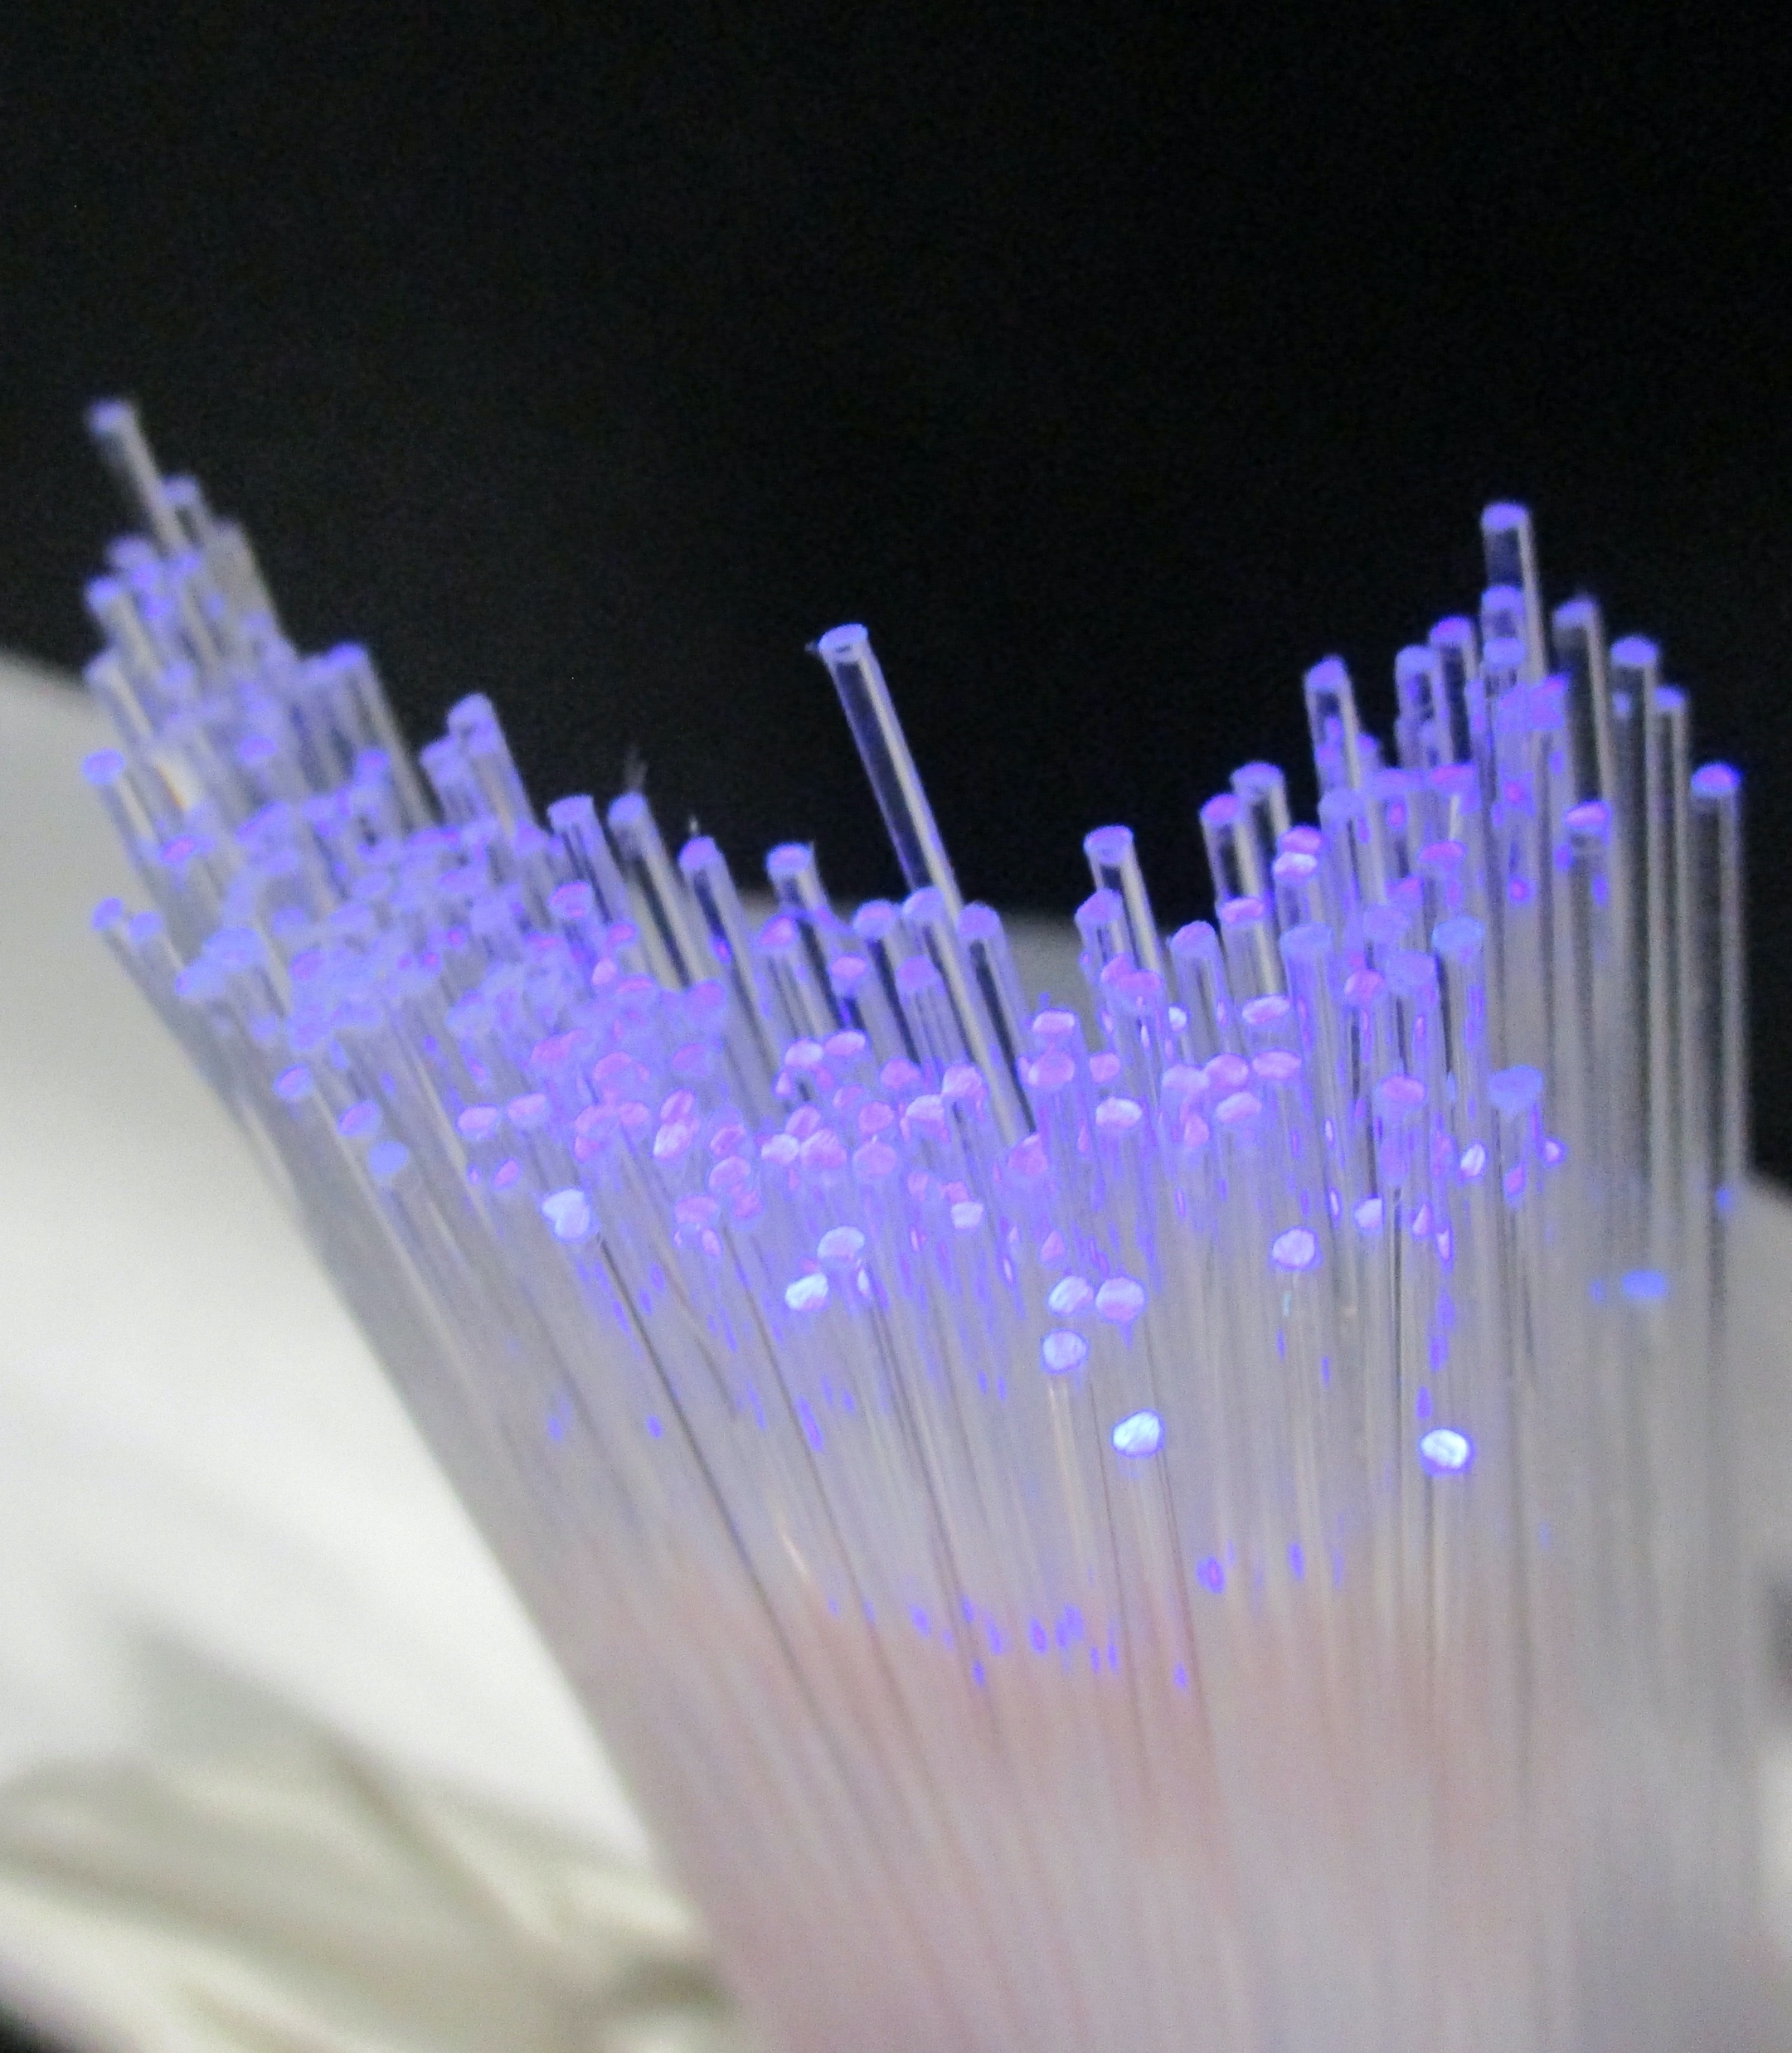
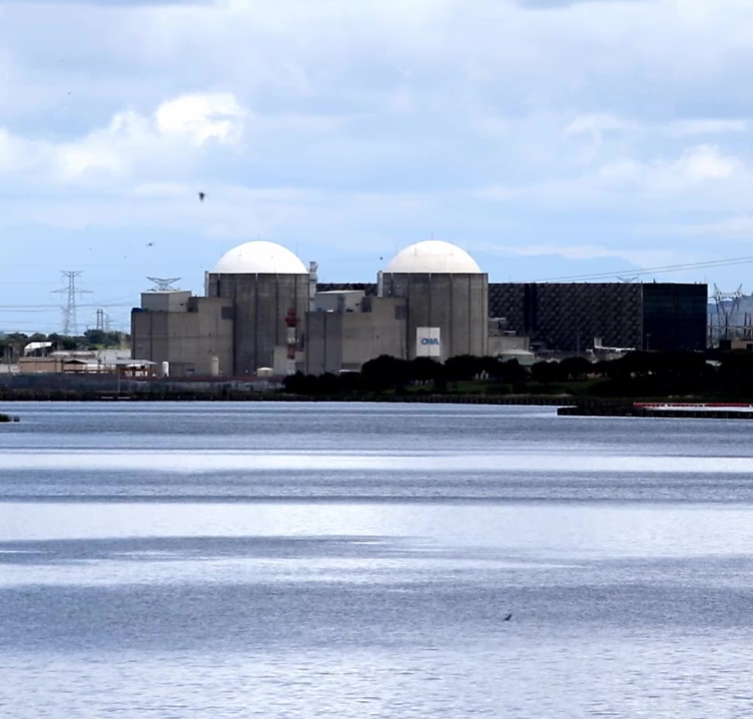

TRITIUM: Design, Construction and Commissioning of an In-Water Tritium Detector
Departament de Física Atòmica, Molecular i Nuclear
TRITIUM: Design, Construction and Commissioning of an
In-Water Tritium Detector
Marcos Martínez Roig
PhD Dissertation
Valencia, July 2022
Marcos Martínez Roig
Supervisors
José Díaz Medina
Nadia Yahlali Haddou
2022
Notes:
1

